Slide 1
ECT 424/IS 324 Class 3
Network Layer, and Internet & Enterprise Systems

Slide 2
Recap
Last week we explored
Layer 2 (OSI Model) – Ethernet LANs, wireless LANs and were getting started on WAN services

Slide 3

MPLS
Multi-Protocol Label Switching
A more efficient way to forward and route packets
MPLS is a technique, not a service
Label Edge Router (LER)
Analyzes each packet on arrival to the MLPS network and puts on a wrapper which tells each router where to forward the packet without reading the header (just the wrapper)
84 % of companies with a WAN are using MPLS
Label | Traffic class/QOS/ECN | TTL | BOS
20 bits | 3 bits | 8 bits | 1 bit
Notes:
MPLS can be considered a Layer 2.5 networking protocol.
MPLS was created in the late 1990’s to avoid having routers waste time by having to stop and look up routing tables. The protocol allows most packets to be forwarded at the Layer 2 (switching) level rather than at the Layer 3(routing) level. Each packet gets labeled at the edge of the service provider's network and that label determines which pre-determined path the packet will follow. The paths, which are called label-switched paths (LSPs), allow service providers to decide ahead of time what will be the best way for certain types of traffic to flow within a private or public network. LSPs are virtual links
MPLS is protocol-independent.

Slide 4
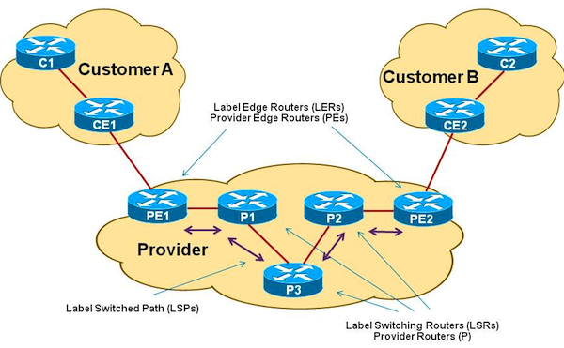
MPLS Components

Slide 5
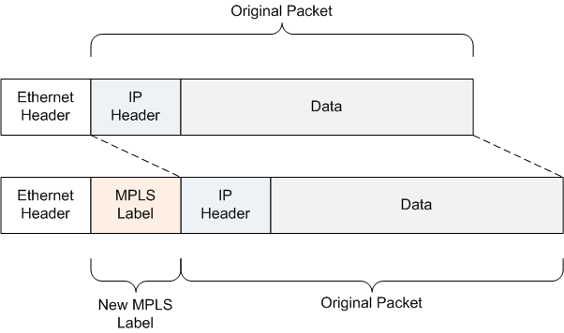
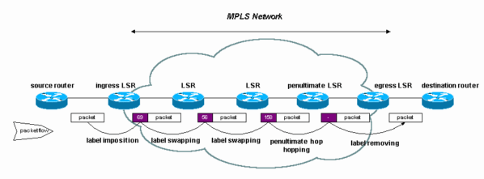
MPLS Network -How it works
Notes:
Ingress – Entrance
Egress – Exit

Slide 6
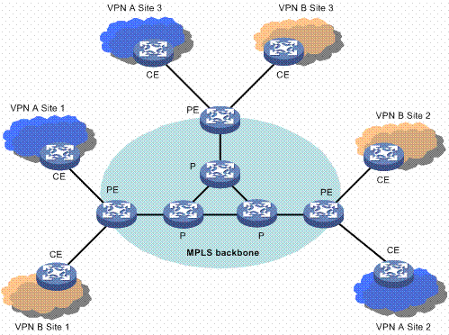
MPLS – Outside Traffic movement
Best parts of circuit switch and packet switch
Uses Labels to select predetermined “routes”
Uses circuit-like techniques within ISP, and packet within Customer
Deploys VPN like features (customer packets remain “private”

Slide 7
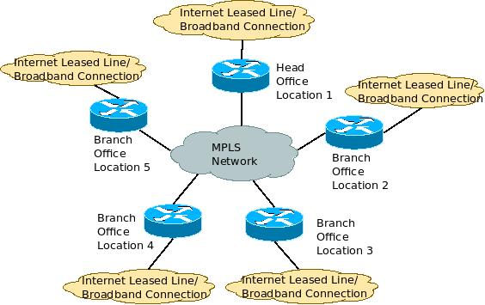
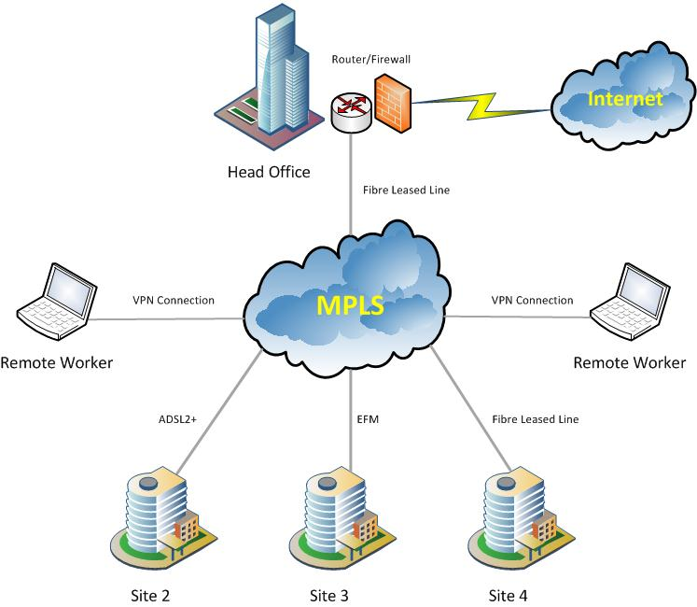
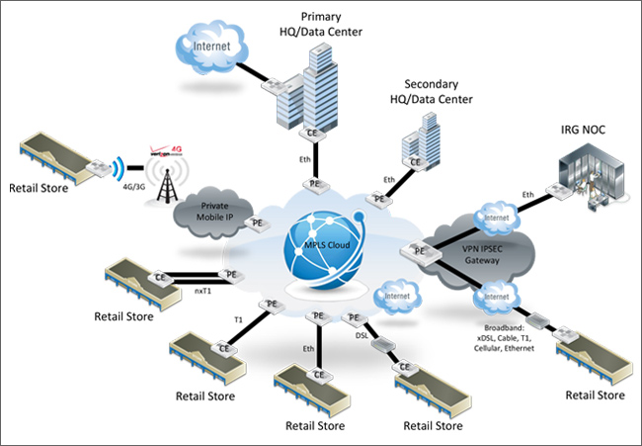
MPLS and the Internet

Slide 8
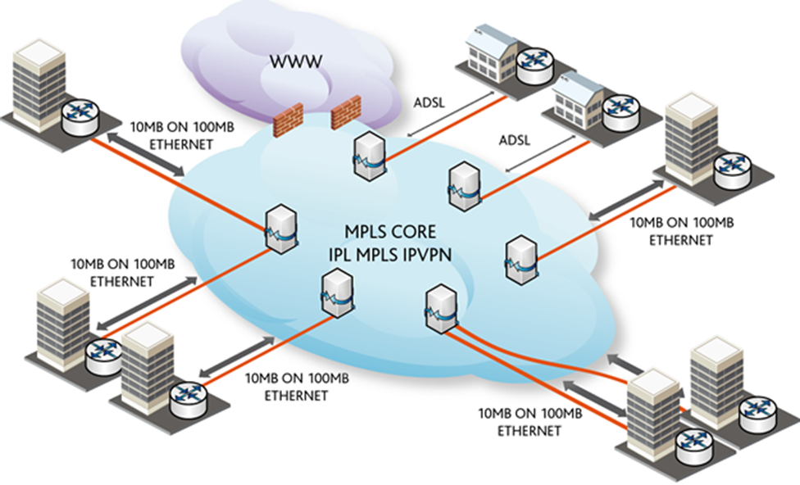
Connecting to MPLS

Slide 9
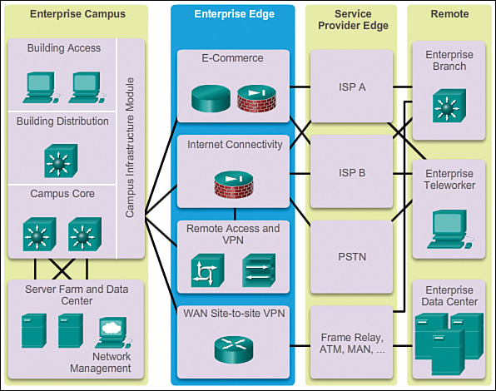
Edge modules
The enterprise edge module provides connectivity for voice, video, and data services outside the enterprise
An edge device primarily enables a local user to connect and transfer data to a network, which is external or is non-propriety to the organization/user. An edge device serves as the entry point into a service provider, carrier or an enterprise primary network.

Slide 10
Edge modules (cont.)
E-commerce networks and servers:
This submodule enables enterprises to support e-commerce applications through the Internet.
Devices located in the e-commerce submodule include
web, application
database servers
firewall and firewall routers
network intrusion prevention systems (IPS).
Internet connectivity and demilitarized zone (DMZ):
This submodule of the enterprise edge provides internal users with secure connectivity to Internet services such as public servers, email, and DNS.
Connectivity to one or several Internet service providers (ISPs) is provided
Devices located in this submodule include
firewall and firewall routers
Internet edge routers
FTP and HTTP servers
SMTP relay servers
DNS servers
Remote access and VPN:
This submodule of the enterprise edge provides remote-access termination service, including authentication for remote users and sites.
Components of this submodule include
Firewalls
dial-in access concentrators
Adaptive Security Appliances (ASA)
Network intrusion prevention system (IPS) appliances.
WAN:
The WAN submodule uses various WAN technologies for routing traffic between remote sites and the central site.
Enterprise WAN links include technologies such as
Multiprotocol Label Switching (MPLS)
Metro Ethernet, leased lines
Synchronous Optical Network (SONET)
Synchronous Digital Hierarchy (SDH)
PPP
Frame Relay
ATM
Cable, digital subscriber line (DSL)
wireless

Slide 11
Multi-Service Ethernet
Ethernet connection into the WAN provider network
Use the big pipe for:
MPLS, P2P or ethernet LAN, SIP (voice) trunks
Outbound only
Notes:
Virtual private LAN service (VPLS) is a technology that makes it possible to connect local area networks (LANs) over the Internet, so that they appear to subscribers like a single Ethernet LAN. A VPLS uses multiprotocol label switching (MPLS) to create the appearance of a virtual private network (VPN) at each subscriber location

Slide 12
This week:
WAN design steps
WAN Topologies
Wireless WAN
WAN Services
HTTP
VPN
Remote Access
Layer 3 –
The Internet
IP Addressing with IPv4 and IPv6
Internetworks – getting from here to there
Layer 4
Ports
Enterprise Architecture Frameworks (if time permits)
Enterprise Systems (if time permits)

Slide 13
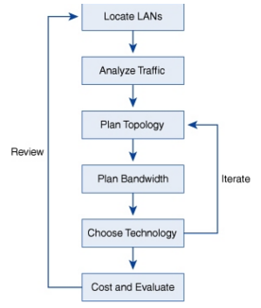
WAN Design Steps
Businesses install WAN connectivity to meet their strategic business requirement to move data between their remote (geographically diverse) branches.
WAN connectivity is important and expensive. Below are some simple steps one must take to design a WAN for the organization

Slide 14
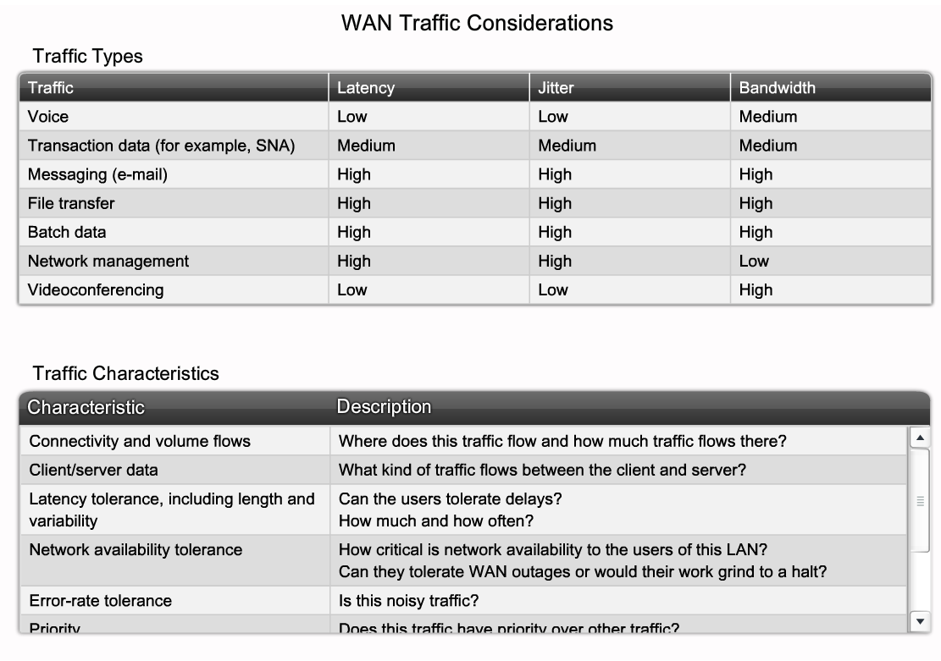
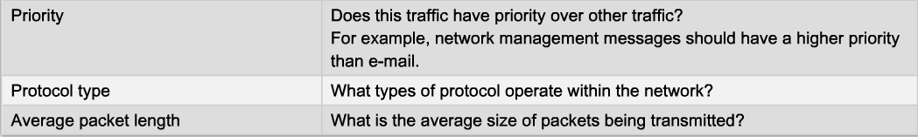
Analyzing Traffic Patterns
Notes:
Latency, ( or DELAY), is an expression of how much time it takes for a packet of data to get from one designated point to another.
Jitter is the variation in the time between packets arriving, caused by network congestion, timing drift, or route changes.
As the name suggests, jitter can be thought of as shaky pulses.
SNA – Proprietary IBM systems network architecture (IBM networking technique)

Slide 15
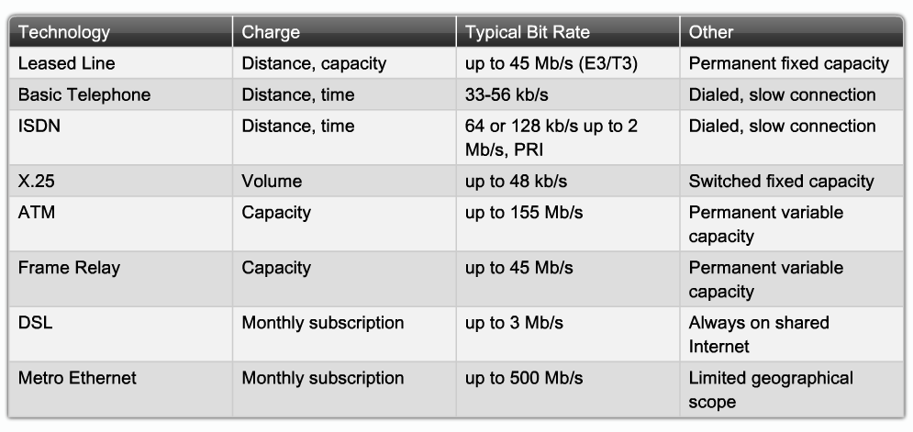
WAN Connection Technologies
Notes:
Leased Line is the most expensive but also the most secure
Basic Telephones and ISDN lines are less expensive but have slow connections. They are Circuit Switched lines
x.25, ATM and Frame Relays are packet switched have used bandwidth efficiently and effectively but can be expensive.
DSL and Metro Ethernet are shared lines, are the least expensive and least secured

Slide 16
WAN topologies
A wide area network (WAN) is a network connecting geographically distinct locations, which may or may not belong to the same organization.
WAN topologies use both LAN and enterprise-wide topologies as building blocks, but add more complexity Why?
distance they must cover
the larger number of users they serve
the heavy traffic they often handle.

Slide 17
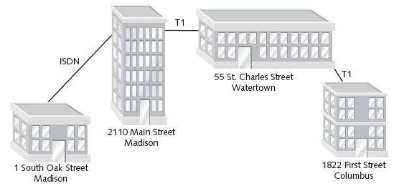
WAN Peer to Peer Topology
The WAN peer-to-peer topology is often the best option for organizations with only a few sites and the capability to use dedicated circuits

Slide 18
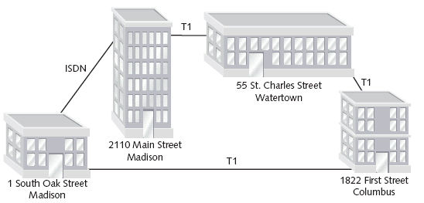
RING WAN
In a RING WAN topology, each site is connected to two other sites so that the entire WAN forms a ring pattern
Advantages of a RING WAN over a peer-to-peer WAN are?
a single cable problem will not affect the entire network
routers at any site can redirect data to another route if one route becomes too busy

Slide 19
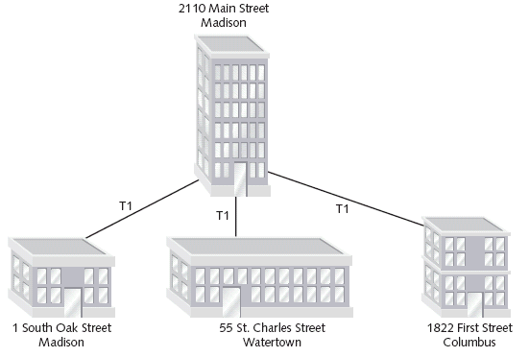
STAR WAN
STAR WAN topology is similar to a STAR LAN. A single site acts as the central connection point for all other sites.
Advantage over Peer to Peer and RING WANs are?
It provides separate routes for data between any two sites
provides shorter data paths between any two sites

Slide 20
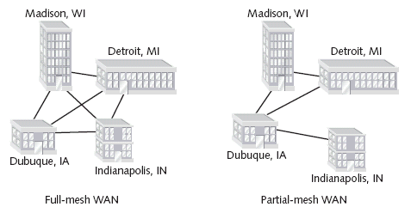
MESH WAN
A MESH WAN topology incorporates many directly interconnected nodes--like geographical locations. Because every site is interconnected, data can travel directly from its origin to its destination. If one connection suffers a problem, routers can redirect data easily and quickly.
Mesh WANs are the most fault-tolerant type of WAN configuration because they provide multiple routes for data to follow between any two points but of course there is a ???? to it!

Slide 21
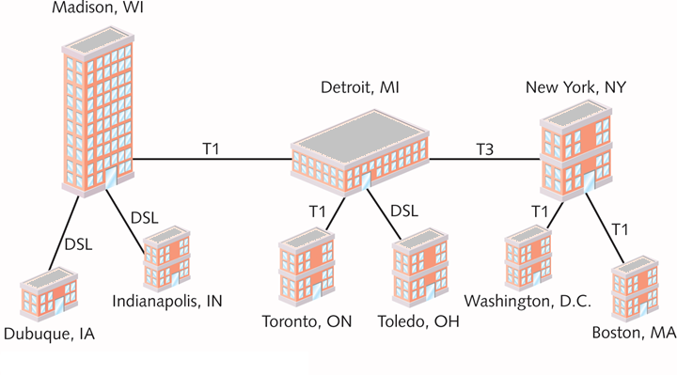
Tiered Topology on WAN
Sites connected in star or ring formations are interconnected at different levels, with interconnection points organized into layers
flexibility makes the tiered approach quite practical. Tiered systems allow for easy expansion and inclusion of redundant links to support growth
Reminds you of a STAR-WIRED BUS LAN? Doesn’t it?

Slide 22
Handy Bandwidth Chart
Type |  | Rate | Additional info
ISDN:
PRI(N America) |  | 1.480Mbps | ISDN 23B+1D (all 64K) ~ T1
xDSL:
ADSL | 640+Kbps up/ 1.544+Mbps down |  | Asymmetric Digital Subscriber Line Nonmatching send/receive transmission rates
SDSL | 768Kbps |  | Single Line Digital Subscriber Line
VDSL | 19.2Mbps up/51.84Mbps down |  | Very high rate Digital Subscriber Line
IDSL | 128Kbps |  | ISDN over low quality non-CAT5 copper
T Carrier:
T1 |  | 1.544Mbps | 24 DS0 channels, equivalent to 1 DS1
T2 |  | 6.312Mbps | 96 channels
T3 |  | 44.736Mbps | 672 channels
T4 |  | 274.176Mbs | 4032 channels
DS0 |  | 64Kbps | 1 channel, same rate in NA, Japan, and Europe
DS1 |  | 1.544Mbps | 24 channels (T1)
DS2 |  | 6.312Mbps | 96 channels (T2)
DS3 |  | 44.736Mbps | 672 channels (T3)
DS4 |  | 274.176Mbps | 4032 channels (T4)
Optical Carrier:
OC-1 |  | 51.48Mbps | SONET - Synchronous Optical Network
OC-3 |  | 155.52Mbps | SONET - Synchronous Optical Network
OC-12 |  | 622.08Mbps | SONET - Synchronous Optical Network
OC-48 |  | 2.4Gbps | SONET - Synchronous Optical Network
OC-192 |  | 9.6Gbps | SONET - Synchronous Optical Network
OC-256 |  | 13.1Gbps | SONET - Synchronous Optical Network
OC-768 |  | 40Gbps | SONET - Synchronous Optical Network
Switched:
10Base2 |  | 10MB/s | Thin coax 607 feet (bus)
10Base5 |  | 10MB/s | Thick coax 1640 feet (bus)
10BaseT |  | 10MB/s | Twisted Pair 328 feet (star)
10BaseF |  | 10MB/s | Fiber 1.2 miles (star)
100BaseT |  | 100MB/s | Twisted Pair

Slide 23
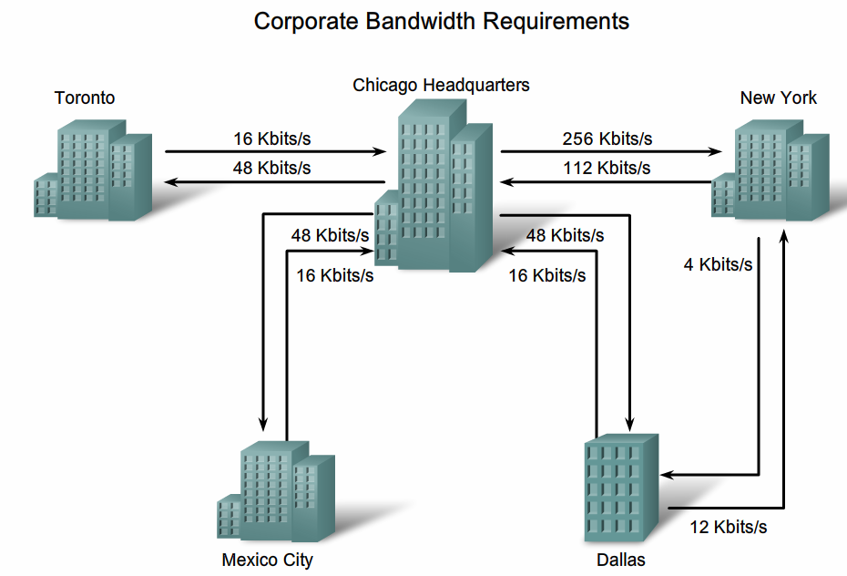
These are examples. They should be set with the terms and conditions of the service provider
©Cisco 2010
Notes:
These are examples. They should be set with the terms and conditions of the service provider

Slide 24
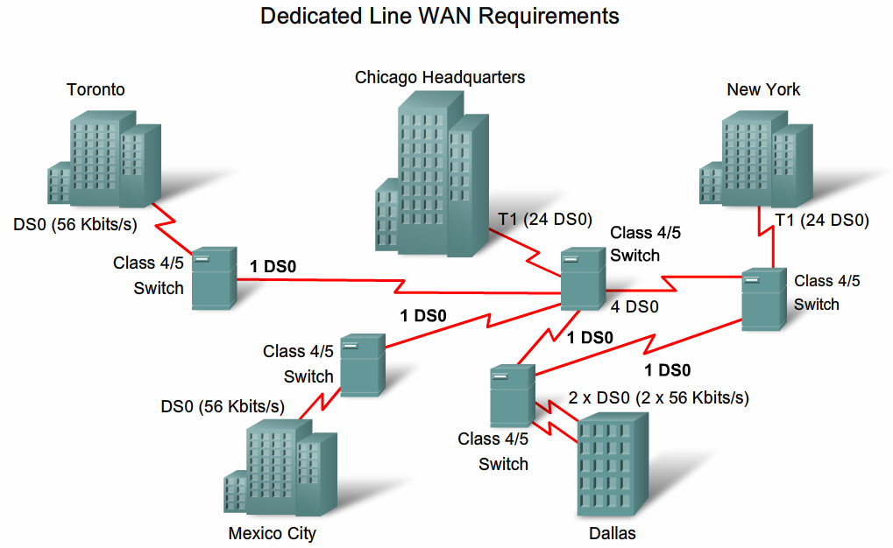
These are examples. They should be set with the terms and conditions of the service provider
©Cisco 2010
Notes:
These are examples. They should be set with the terms and conditions of the service provider

Slide 25
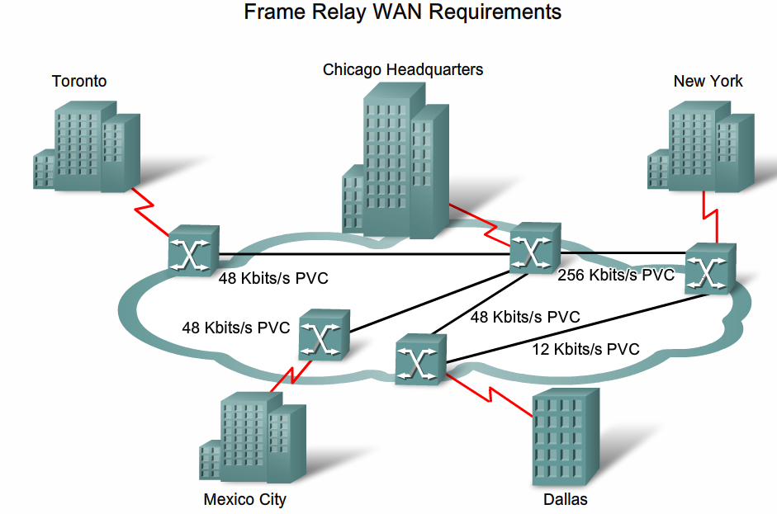
These are examples. They should be set with the terms and conditions of the service provider
©Cisco 2010
Notes:
PVC – Permanent Virtual Circuit

Slide 26
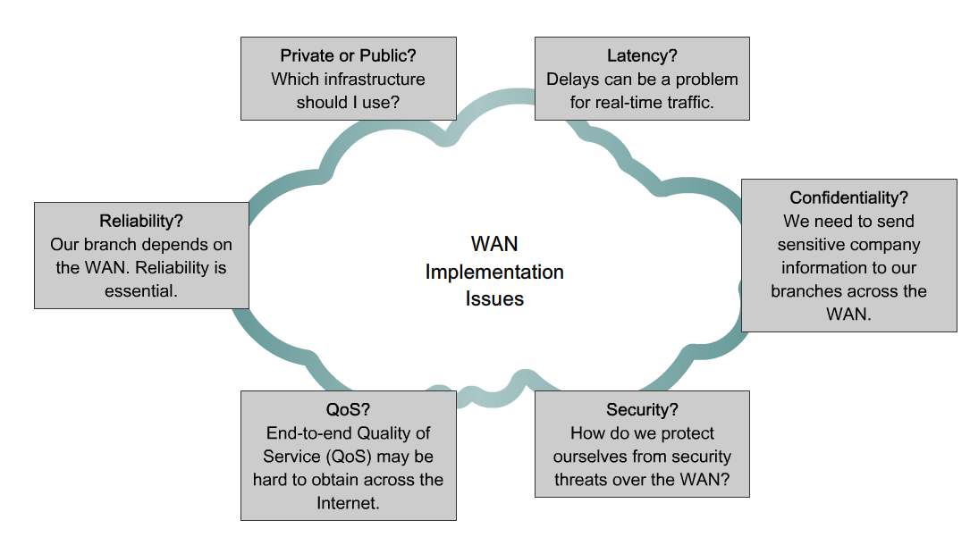
Common WAN Implementation Issues
Cisco©2010

Slide 27
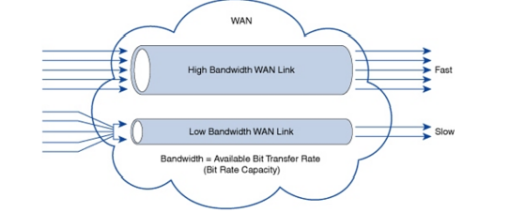
Bigger is better?
Many companies rely on high speed data transfer between remote locations so it is imperative that they have higher bandwidth for more data to be transmitted at any given time.. ….However….
When bandwidth is inadequate or inefficiently managed, competition between the various types of data traffic will cause delay leading to lower employee productivity and monetary losses to the company

Slide 28
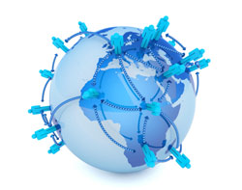
So what can be done besides a bigger pipe?…
So what else can we do to improve the capacity of the WAN?
Answer:
Optimization
Virtualization

Slide 29
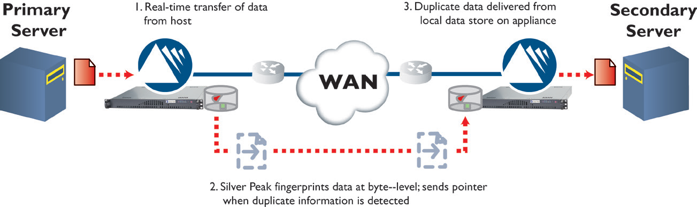
Other than bigger..
We can deduplicate the data on the WAN
A WAN optimization device with deduplication capabilities will have a local cache on both the sending and receiving ends of the connection. If either end calculates that the data has already been sent to the other site, then only the reference information -- not the entire data set -- is sent.
Notes:
One of the best uses of data deduplication is on the wide area network (WAN). The role of data deduplication over the WAN is to allow WAN segments to be more efficiently utilized in order to delay or even prevent the need to purchase additional and expensive WAN bandwidth.

Slide 30
Wireless WAN
MAN, WAN

Slide 31
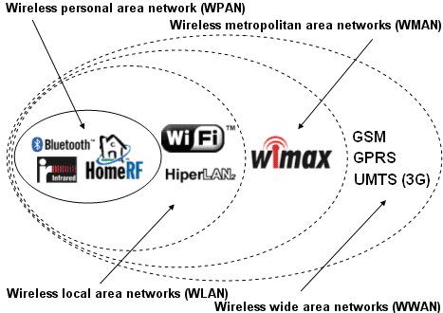
WMAN
LTE (4G)
Notes:
LTE is a WWAN

Slide 32
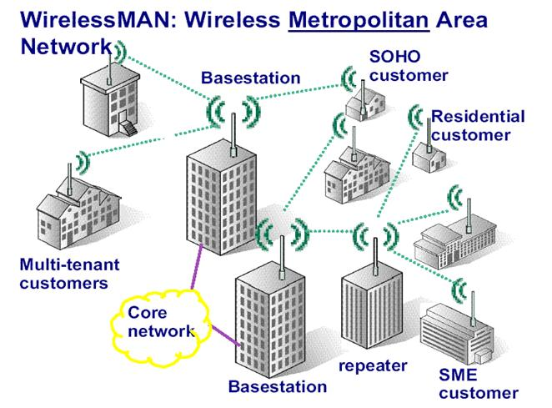
Point to Point Transmissions
WMAN is also often called
WIMAX
Notes:
WMAN is also often called WiMAX

Slide 33
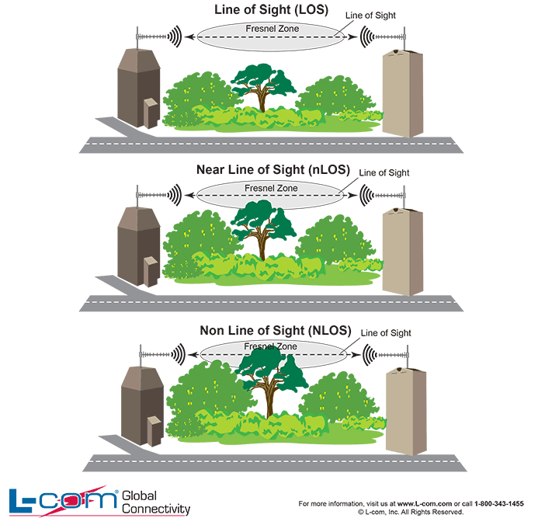
Line of Sight
Issues:
Limited Distance
Weather is a factor

Slide 34
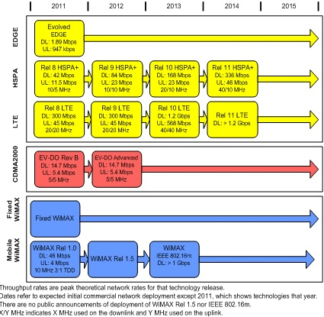
WWAN
Wireless WAN- Also called "wireless broadband“, use cell towers to transmit a radio signal within a range of several miles to a moving or stationary device.
WWAN services are typically delivered by cellular service providers
4G LTE (Long Term Evolution) is the latest evolution in wireless broadband (introduced December 2009)

Slide 35
Other WAN Services

Slide 36
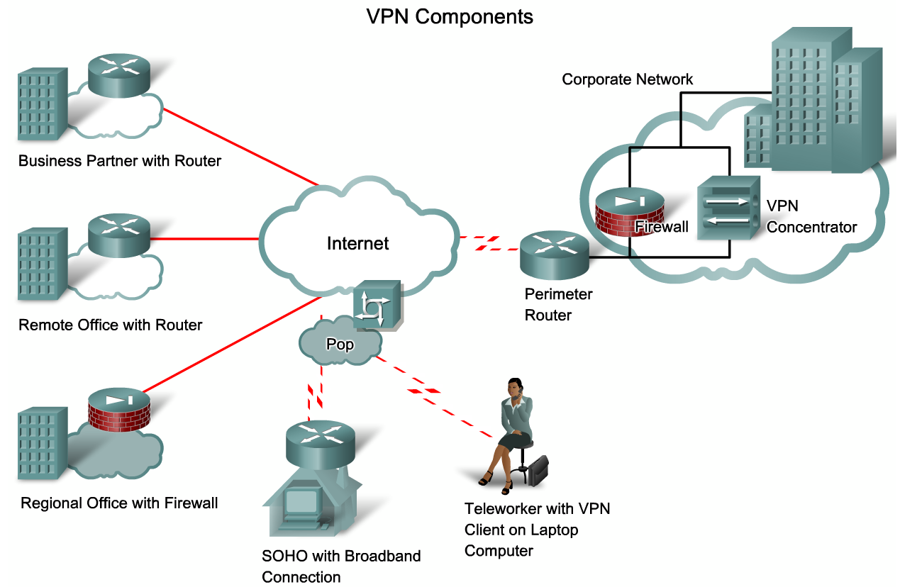
Remote Access
Provide access
Provide access for remote locations and workers
©Cisco 2010

Slide 37
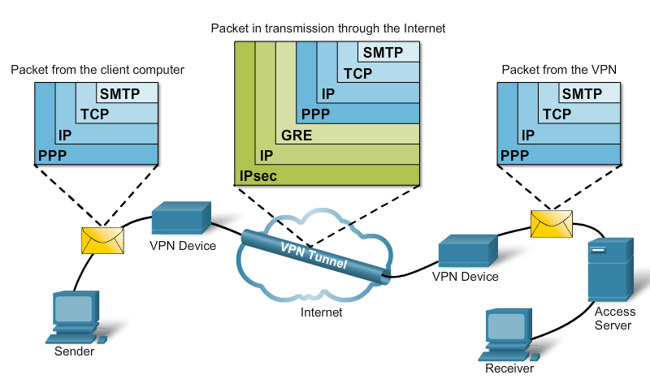
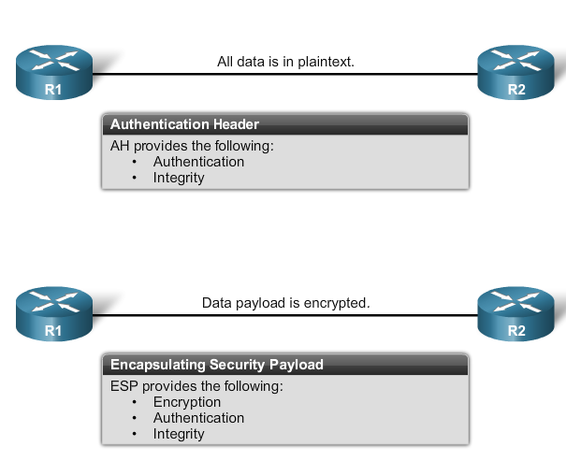
Virtual Private Networks (VPNs)
VPN is a private network over a public network (internet). A VPN may or may not be IP-based.
©Cisco 2010

Slide 38
VPN
My packet gets to the VPN enabled edge device
It takes my packet (encrypts it), puts it into an envelope and addresses the envelope to the edge device at the destination (using Ipsec mostly)
At the destination – edge device opens the envelope (throws it away), decrypts the packet and forwards within the network to final destination

Slide 39
Memo 2
What am I looking for?
What to do about our WAN infrastructure
Do some research
Is what we have adequate (I don’t think so)
What should we do (buy more, what kind, how much)
Change what we do (how, what techniques)
On the addition of a Sales site, what happens to your WAN recommendation if we host that at Hoffman Estates? Is there a better option?

Slide 40
Network Layer Protocol in use is Internet Protocol (IP)
Internet Layer
IPv4 IPv6 IPsec
Originally developed for APRANET by the DoD in the early 1960s. Used by BITNET and other networks that make up the Internet.
Address is the IP address, Data Unit is Packet

Slide 41
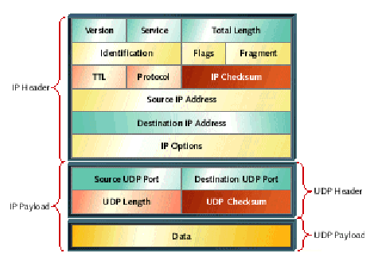


Lets try this metaphor
How Does IP transmit packets?
To:
From:
Header
Text Data
Text Data
Text Data

Slide 42
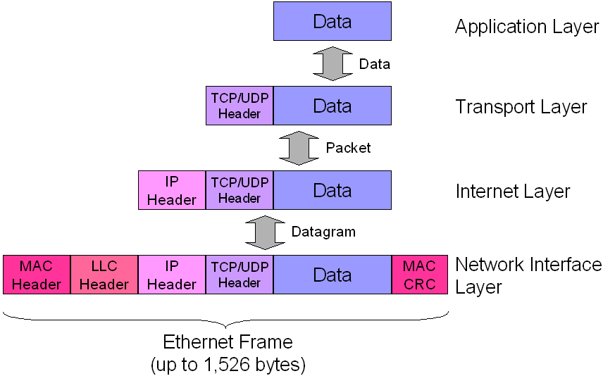
IP Data Transmission
Notes:
MAC - media access control
TCP – transmission control protocol
UDP-user datagram protocol
LLC- logical link control
CRC-cyclic redundancy check

Slide 43
Internet Names and Addresses
Internet Corporation for Assigned
Names and Numbers (non profit)
http://www.youtube.com/watch?v=IJY5xJKPhjA
ICANN
Address
SO
Domain Name
SO
Protocol
SO
Regional Internet Registries
LACNIC
AfriNIC
ARIN
www.arin.net
APNIC
RIPE
Notes:
ICANN is headquartered in California
So owning a top level domain can be beneficial. For example: The domain name .tv is the Internet country code top-level domain for the small Pacific island nation of Tuvalu. Tuvalu gets royalties every time someone wants to use the .tv as a domain name.
ARIN is the American Registry for Internet Numbers
LACNIC is the Latin America and Caribbean Network Information Centre
APNIC is the Asia-Pacific Network Information Centre
AfriNIC is the African Network Information Centre
RIPE is the Réseaux IP Européens Network Coordination Centre

Slide 44
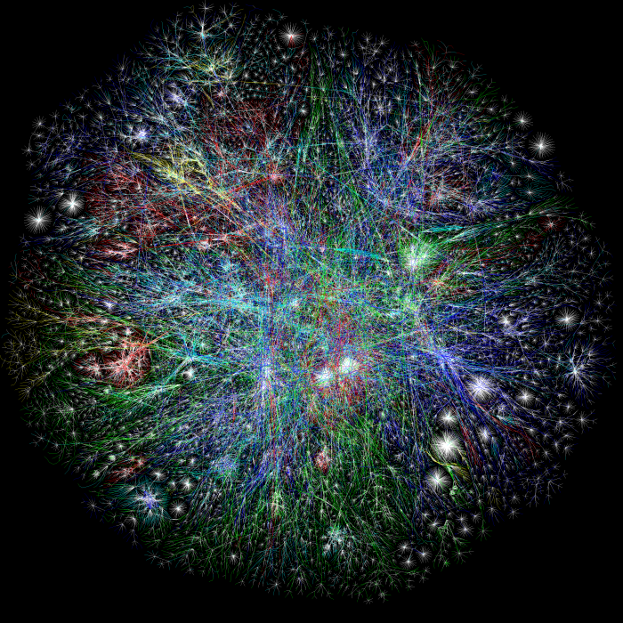

The Opte Project
The Opte Project is a project that seeks to make an accurate representation of the extent of the Internet using visual graphics
The internet in 2003
The internet in 2010
Source: http://www.opte.org/the-internet

Slide 45
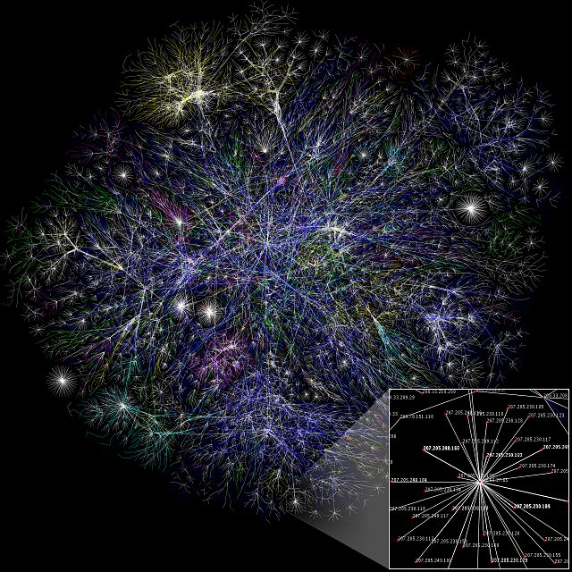
The Opte project is a visualization of Internet routing paths
Each line is drawn between two nodes, representing two IP addresses. The length of the lines are indicative of the delay between those two nodes.

Slide 46
IP Addresses
IP v4
Dotted quad (32 bits – 4 sets of 8 bits)
140.192.38.98
4.3 billion addresses
Ip v6
128 bits (8 sets of 4 Hex values [each Hex == 4 bits])
2001:0db8:85a3:0000:0000:8a2e:0370:7334
General unicast address format (routing prefix size varies)
bits | 48 (or more) | 16 (or fewer) | 64
field | routing prefix | subnet id | interface identifier

Slide 47
Assigning IPv4 Addresses to Nodes
Public addresses
Static
Good for stuff that doesn’t move (printers, servers)
High management costs
Dynamic (DHCP)
Good for stuff that moves, can accommodate stuff that doesn’t
Better management
NAT (network address translation) with Private address
Allows me to use private addresses, swaps to public address as needed
Slows traffic

Slide 48
Addressing in IPv6
Slated to replace the current IP protocol, IPv4
Better security
Better address management (can be automated more easily)
Perhaps the most valuable advantage IPv6 offers over IPv4 is its promise of billions and billions of additional IP addresses through its new addressing scheme (128 bits)
Address format: F:F:0:0:0:0:3012:0CE3
000F:000F:0000:0000:0000:0000:3012:0CE3
8×(4×4))=128 bits
F:F::3012:0CE3
Notes:
Although IPV6 has been around for some time now, the problem that IPv6 solves is it provides a larger IP address space than IPv4. However, no one gets the full benefit of IPv6 deployment until everyone supports it.
In essence, organizations delayed investing in IPv6 until they absolutely had to.

Slide 49
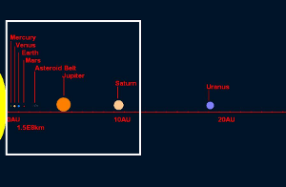
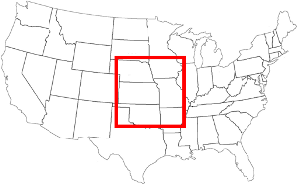
IPv6 – What you need to know
Much Larger address space!
Total IPv4 Space: 4,294,967,296 addresses (2³² or 4.3Billion)
Total IPv6 Space: 340,282,366,920,938,463,463,374,607,431,768,211,456 addresses ( 2¹²⁸ or 340 trillion, trillion, trillion)
The white area is a monitor where each pixel is one ip (and the res is 105 pixels/ lin inch) – about the distance
Sun to Saturn +200 mill miles
If instead I said each pixel is the size of the full IPv4 address space (4.3 bill), how many of these is the IPv6 address space? My monitor would be 645 miles wide!
So we could assign an IPV6 address to EVERY ATOM ON THE SURFACE OF THE EARTH, and still have enough addresses left to do another 100+ earths.

Slide 50
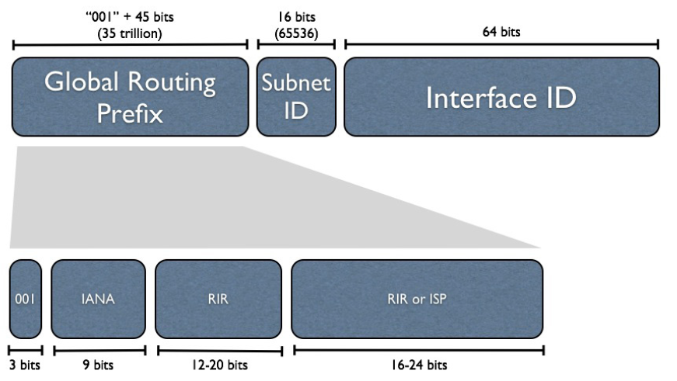
IPv6 Address Construction
All start with 2001
Get /48 address/site
Party responsible for the value of GRP
Notes:
IANA- Internet Assigned Numbers Authority
RIR-Regional internet Registry
ISP- Internet Service Provider

Slide 51

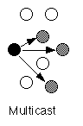

Addressing in IPv6
Link Local
similar to the unicast address in IPv4-a single address identifying a single interface
Type of IPv6 address that represents a single route on a device used for single subnet, start with fe80:
Similar to NAT address space, but now each org can have their own
Multicast address
Multicast in IPv6 is similar to the old IPv4 broadcast address
Type of address in IPv6 that represents multiple routes, often on multiple nodes
No Broadcast address
Anycast address
Type of address specified in IPv6 that represents a group of routes, any of which can accept a transmission
NOTE: No broadcast addresses are used
Notes:
In a computer network, a link-local address is a network address that is valid only for communications within the network segment that the host is connected to. Link-local addresses are usually not guaranteed to be unique beyond a single network segment. Routers therefore do not forward packets with link-local addresses.
Multicasting is used to allow a single device to send a datagram to a group of recipients. Multimedia uses multicasting
Anycast is a network addressing and routing methodology in which datagrams from a single sender are routed to the nearest node in a group of potential receivers

Slide 52
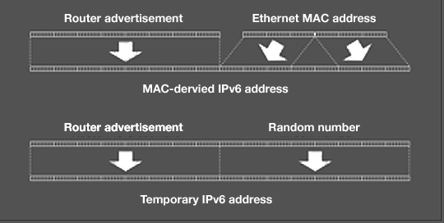
Stateless auto configurations
Allows the various devices attached to an IPv6 network to connect to the Internet without requiring any intermediate IP support in the form of a Dynamic Host Configuration Protocol (DHCP) server.
Router advertises
Top 64 bits
Lower 48 host gen from MAC (plus a special filler FFFE)
00:0a:95:f5:24:6e
20a:95ff:fef5:246e (lower 64)
DHCPv6 is used for DNS and GW

Slide 53
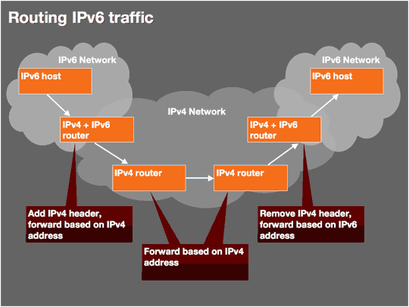
Done with Dual Stacking protocols * preferrerd
or
6to4 tunneling

Slide 54
IPv6 Security
Better
Can use Authentication Header and IPSec
Provides for both data security and integrity because it encrypts traffic and checks packet integrity to provide VPN-like protection for standard Internet traffic.

Slide 55
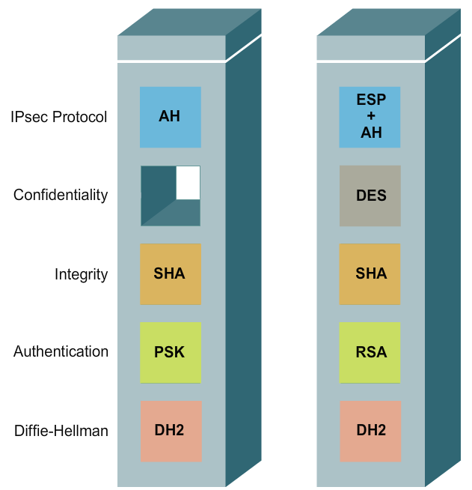
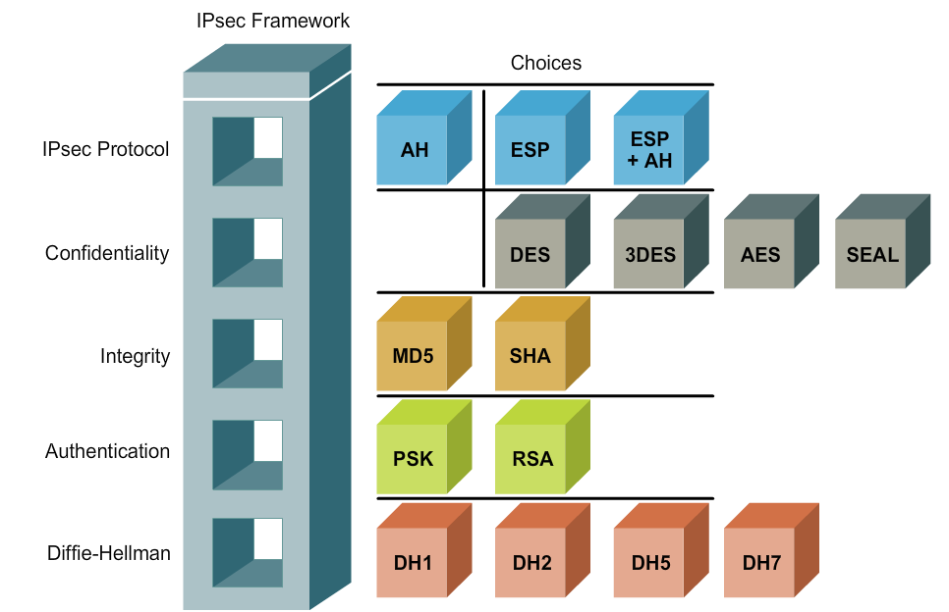
IPSec Choices
Even though the IPv6 standards have mandated support for IPSec; note that IPSec by itself can not stop all attacks against the IPv6 protocol, such as application-level attacks.
Notes:
AH- Authentication headers
ESP-Encapsulating Security Payloads
DES,3DES – CRYPTIC algorithms
MD5, SHA - message-digest algorithms for data integrity
PSK – Pre-shared Key,
RSA- One of the first Public key
DH- Key exchange methods

Slide 56
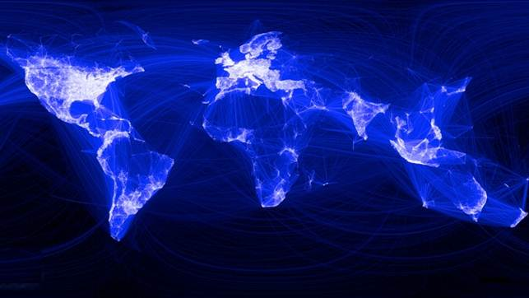
The Internet is not the WWW
What is the difference between the Internet and the WWW?
The Internet is a massive network of networks, a networking infrastructure. It connects millions of computers together globally.
The World Wide Web, or simply Web, is a way of accessing information over the medium of the Internet. It is an information-sharing model that is built on top of the Internet. It is simply one application that runs over the Internet

Slide 57
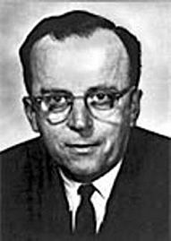


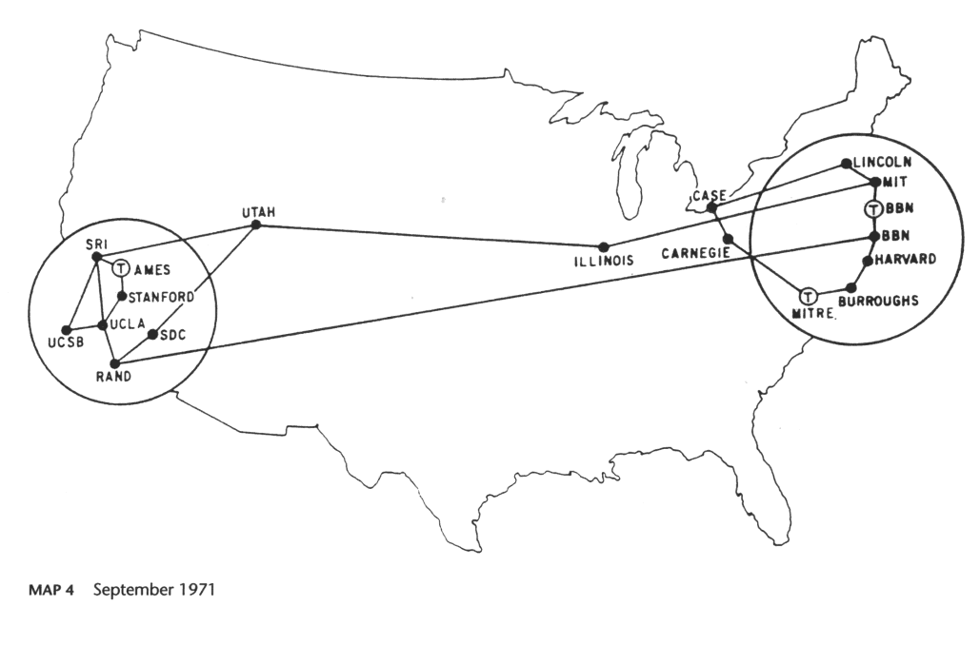

History of Internet
Started 1960s - Packet Switching
Research project by U.S. Dept. of Defense
ARPAnet
USENET
WWW
Linklider
Cerf
Often called the “poor man’s ARPAnet”
Was like a bulletin board
Gore
Notes:
ARPAnet - Advanced Research Projects Agency Network
ARPAnet was the predecessor to the Internet

Slide 58



World Wide Web
1989 Tim Berners-Lee developed concept of HTTP
1992 Lynx text browser
1993 Marc Andreessen developed Mosaic: First GUI browser
1995 Web went commercial (March)
1995 Netscape IPO (went public) (Nov)
2001 E-Commerce stocks crashed
2003 “Web2.0” coined (O’Reilly)
Tim Berners-Lee
Marc Andreessen
Eric Bina
Notes:
"In the Web's first generation, Tim Berners-Lee launched the Uniform Resource Locator (URL), Hypertext Transfer Protocol (HTTP), and HTML standards with prototype Unix-based servers and browsers. A few people noticed that the Web might be better than Gopher (an internet app)
In the second generation, Marc Andreessen and Eric Bina developed NCSA Mosaic at the University of Illinois. Several million then suddenly noticed that the Web might be better than sex.
In the third generation, Andreessen and Bina left NCSA to found Netscape..."

Slide 59
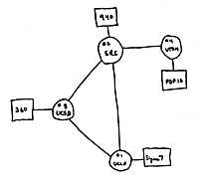
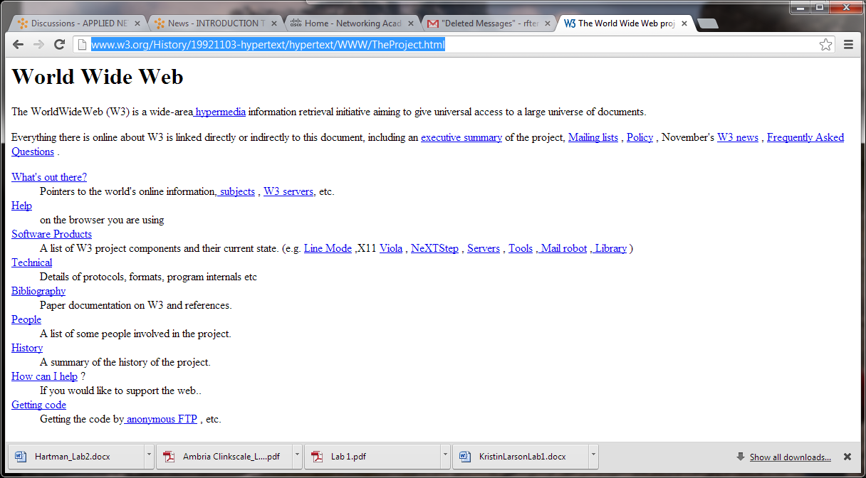
A little History
This is the first HTTP based web page
http://www.w3.org/History/19921103-hypertext/hypertext/WWW/TheProject.html

Slide 60

How does the WWW work?
news.com
amazon.com
cnn.com
chicago.com
yahoo.com
Servers
Nodes
depaul.edu
microsoft.com
Router

Slide 61
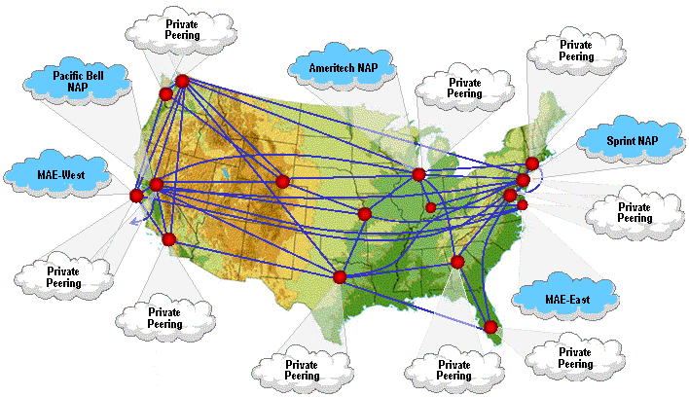
Internet Connections – NAP/IXP
Notes:
NAP-Network Access Point
IXP-Internet Exchange Protocol

Slide 62

IXP and ISP
Notes:
Internet Exchange Protocol and internet Service Provider

Slide 63

International IXP
http://www.telegeography.com/research-services
http://www.bgp4.as/internet-exchanges

Slide 64

Global Fiber Links
http://www.telegeography.com/research-services

Slide 65


http://www.telegeography.com/research-services

Slide 66


http://www.telegeography.com/research-services
NETFLIX is now the largest source of internet traffic in the United States
Notes:
NETFLIX is now the largest source of internet traffic in the United States

Slide 67


Global Internet Access
http://cloudscorecard.bsa.org/2013/assets/images/worldmap_redone.jpg

Slide 68
Today, I want to explain how a browser gets a web page
heh heh heh

Slide 69
1. Browser says…
“I am interested in being served the information in a particular file” and sends a URL to a text address (with a default port) and with a specific file name
http://www.this-is-a-site.com/gimme.html
http://www.this-is-a-site.com:80/gimme.html
At this point, the easiest way to think of a port is as an apartment number in an apartment building, or a mailbox at your local post office

Slide 70
URL: Universal Resource Locator
Four parts to each one (some parts optional)
Protocol
Domain name or server IP address
Director(ies)
File name [suffix is important to the server]
http://www.cdm.depaul.edu/Pages/default.aspx
Protocol
Domain Name
File Name
Directory

Slide 71
Each Computer has an IP Address
126.1.1.1
15.35.200.2
126.12.1.1
15.35.200.1
15.35.200.3
126.12.1.6
126.12.1.5
132.12.1.5
132.12.1.7
126.12.1.7
132.12.1.6
132.12.1.2
245.12.50.6
126.12.1.3
126.12.1.2
132.12.1.4
245.12.50.9
126.12.1.4
152.123.200.1
245.12.50.8
152.124.20.8
132.12.1.3
245.12.50.7
152.124.20.6
152.124.20.7
132.12.1.1
245.12.50.5
172.11.11.16
172.11.11.14
152.124.20.2
152.124.20.5
146.182.5.5
145.12.50.1
172.11.11.15
152.124.20.3
146.182.0.1
172.11.11.10
152.124.20.4
146.182.0.7
146.182.0.2
172.11.11.8
172.11.11.12
146.182.0.6
172.11.11.11
172.11.11.1
172.11.11.13
146.182.0.3
172.11.11.7
172.11.11.9
146.182.0.4
172.11.11.2
146.182.0.5
172.11.11.6
172.11.11.3
172.11.11.4
172.11.11.5

Slide 72
2. URL goes to a DNS
Device calls a Domain Name Server to translate text URL into a numeric IP address.
www.this-is-a-site.com = 128.142.112.108
If the DNS does not know the site, it forwards the text URL upstream to a DNS that does know it. If no DNS can report the IP address, then an error message is returned.

Slide 73
IP addresses are translated as Domain Names
news.com
amazon.com
cnn.com
chicago.com
yahoo.com
www.chicago.com
www.cti.depaul.edu
www.yahoo.com
www.microsoft.com
depaul.edu
www.depaul.edu
microsoft.com

Slide 74
Domains
International
com Usually a company or other commercial institution or organization, such as www.ibm.com
net Gateways and other administrative hosts for a network
org A private organization, such as www.greenpeace.org
biz Similar to .com
US Only
edu An educational institution, such as www.depaul.edu
gov A government site, such as www.irs.gov
mil A military site, such as www.af.mil (Air Force)
Each country also has its own top-level domain
au Australia; ca Canada; fr France; uk The United Kingdom. These also have sub-domains of things like ac.uk for academic sites and co.uk for commercial ones
me -- country code for Montenegro
tv -- country code for Pacific Island country of Tuvalu
Names are managed by ICANN

Slide 75
Domain Name Server
www.yahoo.com (Domain Name)
64.58.76.223 (IP Address)

Slide 76

Iterative/Recursive

Slide 77
3. HTTP Packet goes to a Router
Gateway Server sends the HTTP packet (a packet of information) upstream into the Internet. It hits a router.
This is a PACKET of information
The router acts as a traffic cop and determines the best possible route for the packet. It then sends the packet along that path to the next router. And so on until it reaches its destination.

Slide 78

Routing Table
R2 address table
for R1 and R3

Slide 79
126.1.1.1
15.35.200.2
126.12.1.1
15.35.200.1
15.35.200.3
126.12.1.6
126.12.1.5
132.12.1.5
132.12.1.7
126.12.1.7
132.12.1.6
132.12.1.2
245.12.50.6
126.12.1.3
126.12.1.2
132.12.1.4
245.12.50.9
126.12.1.4
152.123.200.1
245.12.50.8
152.124.20.8
132.12.1.3
245.12.50.7
152.124.20.6
152.124.20.7
132.12.1.1
245.12.50.5
172.11.11.16
172.11.11.14
152.124.20.2
152.124.20.5
146.182.5.5
145.12.50.1
172.11.11.15
152.124.20.3
146.182.0.1
172.11.11.10
152.124.20.4
146.182.0.7
146.182.0.2
172.11.11.8
128.142.112.108
146.182.0.6
172.11.11.11
172.11.11.1
172.11.11.13
146.182.0.3
172.11.11.7
172.11.11.9
146.182.0.4
172.11.11.2
146.182.0.5
172.11.11.6
172.11.11.3
172.11.11.4
172.11.11.5
This really happens hop to hop!

Slide 80
4. HTTP Packet hits destination IP
Assuming no error, the computer at the destination site receives the packet. It determines which port to allow the packet in.
If a port is explicitly specified, that port is used. If not, if there is an HTTP prefix, port 80 is assumed.
A word about Firewalls

Slide 81




FW and DMZ
Notes:
DMZ is the demilitarized zone of the network. DMZ machines are in an isolated network segment.
The intention is to ensure that publicly accessible servers cannot contact other internal network segments, in the event that a server is compromised.

Slide 82
Ports
Some Common
“Well-Known” Ports
Number | Description
20 | FTP – Data
21 | FTP -- Control
22 | SSH Remote Login Protocol (secure)
23 | Telnet Remote Login Protocol (unsecure)
25 | Simple Mail Transfer Protocol (SMTP)
53 | Domain Name System (DNS)
80 | HTTP
110 | POP3
143 | Interim Mail Access Protocol (IMAP)
156 | SQL Server
194 | Internet Relay Chat (IRC)
443 | HTTPS (http over secure socket layer, not the same as s-http)
458 | Apple QuickTime
Each of the services operate at a specific location
Called a Port
Operates at the Transport Layer of the OSI/TCP model

Slide 83
5. Packet is given to WebServer
An HTTP packet is handed to the WebServer software (via port 80) or to the service requested by the port in the packet.
The WebServer software parses the packet and decides what to do with it.
It has lots of decisions to make.

Slide 84
6. Parsing Process
HTTP://www.this-is-a-site.com/gimme.html
IF there a file name at the end
THEN IF the suffix is .htm or .html
THEN traverse directories, find file, send file
ELSE IF suffix is .asp (or similar)
THEN send to program to interpret URL data
ELSE IF exists
THEN send the default file in the directory
ELSE send error message (404)

Slide 85
7. File is returned to the sending IP address (already in numeric form)
The file is likely broken into several packets, each sent separately. Each packet has a header with both the sending and receiving IP address.
The packets may go different routes and arrive in a different order.
A protocol is responsible for collecting them and putting them in order to be passed up to the requesting application.

Slide 86
Web Servers provide Services
WWW
This service hands out web pages, using HTML (or one of it variants)
Email
This service sends and receives email for the domain
FTP
The service handles the transfer of files to and from the server
Telnet
This service allows for remote connections to the server from a remote host
Each of these require a server (service) side (a daemon) and a client side (client)

Slide 87
HTTP
Most basic command is GET
This will cause the server to retrieve from its files the requested page
The GET will retrieve the full URL
http://www.cdm.depaul.edu/index.htm
This allows multiple sites to be located on the same machine
This is called virtualization, or shared hosting
Notes:
Hyper Text Transfer Protocol

Slide 88
What makes an Enterprise System?
A system that supports enterprise-wide (cross-function) requirements (rather than a single department or group within the organization)**
Generally, an enterprise system is one that would have a major impact on a business whether it fails or works.
The system architecture may have to include many entities (supply-chain, customers, prospects, stakeholders, non-clients, anti-clients, govt, community
**Debatable
Notes:
Enterprise systems are usually cross departmental (Finance, HR, Marketing, Sales etc)

Slide 89

Every System Has These Parts
Computer-based information systems are composed of:
Hardware (physical components)
Software (programs of instructions)
A Database (the information must be stored)
A Network (connectivity to the world)
Procedures (business rules for the system)
People (users/roles for the system)
Notes:
Hardware is a device such as a processor, monitor, keyboard or printer
Software is a program or collection of programs that enable hardware to process data.
Database is a collection of related files or tables containing data.
Network is a connecting system (wireline or wireless) that permits different computers to share resources.
Procedures are the set of instructions about how to combine the above components in order to process information and generate the desired output.
People are those individuals who use the hardware and software, interface with it, or uses its output.

Slide 90

Information Systems Inside the Organization
Notes:
OAS – Office Automation Systems
FAIS – Fully Automatic Information Systems

Slide 91

Where does data start?
For an enterprise – it starts with transactions
These are the day to day interactions (sales) of the organization
There has to be a system in place to manage/monitor/complete the transactions
This is a Transaction Processing System (TPS)

Slide 92

Transaction processing systems
Most people think about mainframes when they think TPS
But TPS are alive and well
Think about buying things on Amazon, or doing Online Banking
These are all TPS

Slide 93



Relationships to other Systems
Country
Notes:
TPS-Transaction Processing Systems
DSS-Decision Support Systems
MIS-Management Information System

Slide 94
Characteristics of TPS
Rapid Response
Input must become output in seconds
Reliability
Failure is NOT an option
Inflexibility
Every transaction must be processed in the same way, standard operations
Controlled processing
Must support organization’s operations
Some examples of TPS are Invoice Processing Systems, Payroll Processing Systems, Ticket Reservation Systems, Purchase order entry forms
Notes:
TPS must be super fast and efficient
TPS can not break
TPS systems are standardized and processed the same way. Think of an invoice processing system

Slide 95



Components of TPS
Hardware
Software
People

Slide 96


Types of TPS
Batch
Real-time
Manual

Slide 97

Thick vs. Thin client Net Operating Systems

Slide 98
2 Tier PAD (packet assembler/disassembler) Architecture
Presentation
Application
Data
Fat Client
Server
Notes:
Short for packet assembler/disassembler PAD is a device (hardware or software) used in packet switching to enable data terminal equipment (DTE) not equipped for packet switching to access a packet-switched network.

Slide 99
Start withPAD Model – 2 Tier
PAD (packet assembler/disassembler) Model – 3 Tier
Presentation
Application
Data
Server
Thin Client
Server
Server
Notes:
packet assembler/disassembler

Slide 100
PAD (packet assembler/disassembler) Model – n Tier
Presentation
Application
Data
Thin Client
Servers
Servers

Slide 101
Underlying Technologies
LANs
Usually a thin client
Access to the servers housing the Business Rules of the Transaction Processing System (TPS)
Always a large Database server
Older models this is a single DB
WANs
Client is similar
Business Rules (application) is distributed (there is often a middleware component as well)
DB is distributed

Slide 102
Readings for this week
Because IT systems have become
unmanageably complex
increasingly costly to maintain and
because they are mission critical…
Enterprise architecture methods help in reducing IT cost and complexity, while increasing business value and effectiveness
4 Enterprise Architecture Methods
Zachman Framework
TOGAF (The Open Group Architectural Framework)
Federal Enterprise Architecture
Gartner/Meta Methodology

Slide 103
Enterprise Architecture
The field of enterprise architecture essentially started in 1987, with the publication in the IBM Systems Journal of an article titled "A Framework for Information Systems Architecture," by J.A. Zachman
Enterprise Architecture sought to address
System complexity where organizations were spending more and more money building IT systems
Poor business alignment where organizations were finding it more and more difficult to keep increasingly expensive IT systems aligned with business need.
The Zachman framework is a logical structure intended to provide a comprehensive representation of an information technology enterprise.
Although self-described as a framework, is actually more accurately defined as a taxonomy
It deals with each meeting point between a player's perspective (for example, business owner) and a descriptive focus (for example, data.)
Each player needs to know the what, how, where, who when and why but each focus is thought of differently by different players.

Slide 104

Zachman Framework
Notes:
As we move horizontally (for example, left to right) in the grid, we see different descriptions of the system—all from the same player's perspective.
As we move vertically in the grid (for example, top to bottom), we see a single focus, but change the player from whose perspective we are viewing that focus

Slide 105


TOGAF The Open Group Architectural Framework
Although called a framework, is actually more accurately defined as a process.
TOGAF is an Architecture Development Method
Zachman tells you how to categorize your artifacts. TOGAF complements Zachman and gives you a process for creating them.
Notes:
The Open Group Architectural Framework

Slide 106
Enterprise Architecture (as a supply chain)

Slide 107

Michael Porter* put all this together in:
Porter’s Value Chain Model
(Understanding How Value is Created Within Organizations)
*Is a leading authority on competitive strategy and the competitiveness and economic development of nations, states, and regions. Professor at The Institute for Strategy and Competitiveness, based at the Harvard Business School. http://www.isc.hbs.edu/Pages/default.aspx
Notes:
Michael Porter is a leading authority on competitive strategy and the competitiveness and economic development of nations, states, and regions.

Slide 108
Profit
Firm Infrastructure
Technology and Product Development
Inbound
Logistics
Operations
Marketing
& Sales
Outbound
Logistics
Service
Procurement
Human Resources

Slide 109
Profit
Firm Infrastructure
Technology and Product Development
Inbound
Logistics
Operations
Marketing
& Sales
Outbound
Logistics
Service
Procurement
Procurement
Supply Chain Management
Human Resources
Notes:
Supply Chain Management

Slide 110

Supply Chain Model is the oversight of materials, information, and finances as they move in a process from supplier to manufacturer to wholesaler to retailer to consumer.

Slide 111

Supply chain management flows can be divided into three main flows:
The product flow
The information flow
The financial flow
The product flow includes the movement of goods from a supplier to a customer, as well as any customer returns or service needs.
The information flow involves transmitting orders and updating the status of delivery.
The financial flow consists of credit terms, payment schedules, and consignment and title ownership arrangements.
Supply Chain Systems track all three

Slide 112
Profit
Firm Infrastructure
Technology and Product Development
Inbound
Logistics
Operations
Outbound
Logistics
Marketing
& Sales
Service
CRM
Procurement
Procurement
Customer Relationship Management
Human Resources
Notes:
CRM

Slide 113

What is the goal of CRM?
To gain insight into the behavior of customers and the value of those customers.
An effective CRM strategy will increase revenues by:
providing services and products that are exactly what customers want
Provide better customer service
cross sell products more effectively
help sales staff close deals faster
retain existing customers and discover new ones
Notes:
CRM goal is better service, more effective sales, retention of customers, discovery of new customers.

Slide 114
Enterprise Resource Planning
System
Profit
Firm Infrastructure
Technology and Product Development
Inbound
Logistics
Operations
Outbound
Logistics
Marketing
& Sales
Service
Procurement
Human Resources

Slide 115
Enterprise Resource Planning defined
A business management system that integrates all facets of the business.
This includes:
planning
manufacturing
sales
marketing.

Slide 116
There are five major reasons why companies undertake ERP.
Integrate financial information
Integrate customer order information
Standardize and speed up manufacturing processes
Reduce inventory
Standardize HR information

Slide 117
Other important systems
Decision Support System
A computer application that analyzes business data and presents it so that users can make business decisions more easily.

Slide 118

Type of DSS
Expert Systems
Decision Analytic Systems
Executive Information Systems
Group Support Systems

Slide 119
Other important systems
Unified Communications System
Integrates real-time communication services with non-real-times services. Provides a single point of contact for communicators and a single data repository for communication artifacts.

Slide 120


Cisco, Microsoft, and others have UC products

Slide 121


IPT or VoIP?
VoIP is a component of IP Telephony.
IP telephony solutions look to provide the exact same services as a public switch telephone network (PSTN) or internal business telephone network, using internet technologies instead of traditional analog lines.
*IPT = IP Telephony
©Cisco 2001

Slide 122


Other important systems
Portals and Intranets
.
An intranet portal is a central location for information and applications within an organization, presented in an electronic format

Slide 123

Intranets and Portals
Both Campus Connection and MyCDM are examples of Intranet Portals
Actually, CampusConnection is an ERP system with a Portal front end
Actually, MyCDM is a CRM system that also serves as a portal to other information

Slide 124

Lots of kinds of systems in the modern enterprise
Many of them are migrating to the cloud

Slide 125
Further, there are significant complementary architectural changes occurring as well
MVC Architecture
Middleware Platforms
Open Source
*I’m talking about this here so you will have some background on what we are doing with WordPress

Slide 126

Model View Controller What it is, and why it is important
The Model – or a connector that stores information of each single table of a database. The model also does the validation of the data before it gets into the database. Most of the time you will find a table in the database and an relating model in your application.
Model stores the FRAMEWORK of the database. It’s a model after all!

Slide 127

Model View Controller What it is, and why it is important
The view – a website we actually see as viewers. Inside the view you will find (most of the time) HTML with embedded Ruby code. It performs tasks related solely to the presentation of the data.

Slide 128

Model View Controller What it is, and why it is important
The controller – small bits of code that gets information from the database and displays it to the view.
The controller knows how to process the data that comes from the model and how to pass it onto the view.

Slide 129

Model View Controller What it is, and why it is important
Separates
Database
Skin Design
Programming

Slide 130

Model View Contoller
Model
database tables (persistent data)
session information (current system state data)
rules governing transactions
View
(X)HTML
CSS style sheets
server-side templates
Controller
client-side scripting
http request processing
business logic/preprocessing

Slide 131







It is about Content Management Systems Systems that decouple architecture, data, and presentation so that each can be managed separately.
Architecture: a software framework for fast modular construction of a system
Data: information stored and organized independent of architecture; ability to change content without touching software
Presentation: an skin independent of architecture and data; ability to change skins

Slide 132


http://www.indeed.com/jobtrends?q=java,c%2B%2B,"content+management"&relative=1&relative=1

Slide 133
What does a CMS framework have?
Modularity
Security Model
Template/Skin/Theme also Language
User/Role Model
Media Management
Taxonomy
Workflow Model
Content Distribution Management
Front End / Back End Dashboard
Notes:
Domains of a CMS
Within an enterprise:
Used as a portal or Intranet
Used to support e-commerce functionality
Used to support workflow and document management
On the Internet
Used to present dynamic information
Used to build community

Slide 134
Uses of a CMS
Blogs (and discussion forums)
News and magazine style publishing
Online books
Social Networks
Knowledge repository
Portal
Enterprise Document Management
Enterprise Workflow Management
E-Commerce site

Slide 135
And this is one reason Why. . .
We are building a form of CMS using WordPress (because it is easy and a good example of an MVC framework)
The message exchange environment we are using is a blog
We could have chosen a Wiki or a discussion board (used to call them bulletin boards or threaded discussions)
But we didn’t!!

Slide 136
For next class
Enterprise Data Center Issues Readings
Memo 1 is due to the Dropbox. Be sure to both upload AND submit!! (if you don’t get an email it wasn’t submitted)
Web 2 is due (please be sure to upload a Word Readable doc with your url or put the URL in the comments part of the upload and upload a blank pdf.)

Slide 137

Memo 1 Activity
Given the handout, design the cabling for this company.
Consider the cable type, where it should go
Where will you put the Equipment Room, Demarc, AP?

Slide 138


